Slide 1
FAKULTAS TEKNOLOGI INFORMASI
ANALISIS TEKS PADA MEDIA SOSIAL
[KP398 – 2 SKS – S1 TEKNIK INFORMATIKA]

Slide 2
MEMAHAMI MEDIA SOSIAL
Pertemuan 02

Slide 3
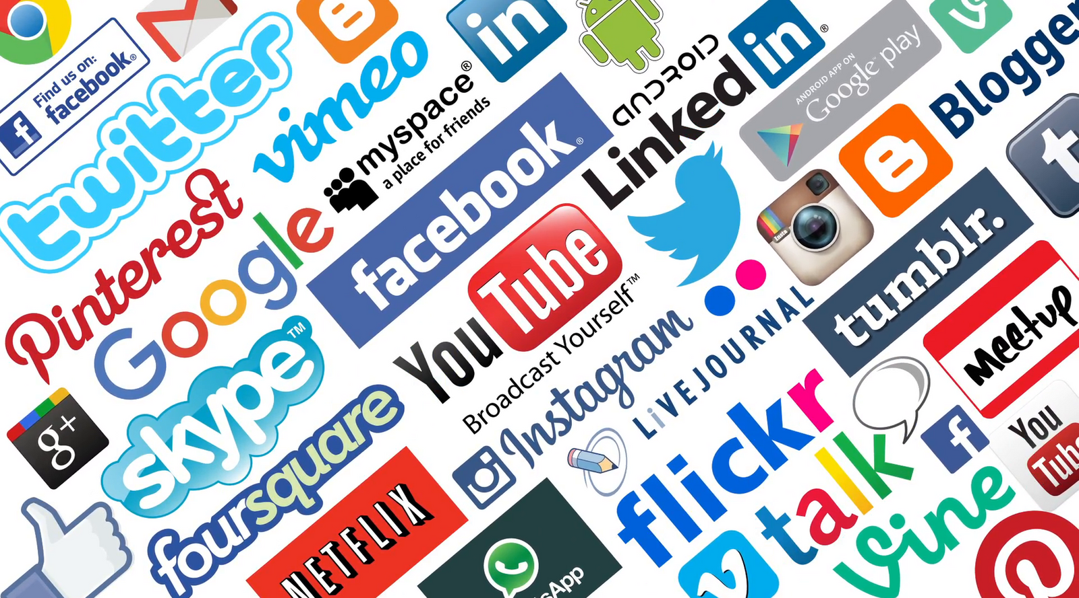
02
Analisis Teks pada Media Sosial
S1 Teknik Informatika
Memahami
DATA MEDIA SOSIAL
Dr. Achmad Solichin, S.Kom., M.T.I.
Universitas Budi Luhur
Notes:
https://wowitloveithaveit.com/blogs/seo-software-tutorials/best-social-media-exchange-sites-list-for-2020

Slide 4
Media sosial adalah teknologi interaktif dan saluran digital yang memfasilitasi kreasi dan berbagi informasi, ide, minat, dan bentuk ekspresi lainnya melalui komunitas dan jaringan virtual.
Notes:
1. Kietzmann, Jan H.; Kristopher Hermkens (2011). "Social media? Get serious! Understanding the functional building blocks of social media". Business Horizons (Submitted manuscript). 54 (3): 241–251. doi:10.1016/j.bushor.2011.01.005.
2. Obar, Jonathan A.; Wildman, Steve (2015). "Social media definition and the governance challenge: An introduction to the special issue". Telecommunications Policy. 39 (9): 745–e669. doi:10.2139/ssrn.2647377.

Slide 5
Media SOSIAL DALAM ANGKA

Slide 6
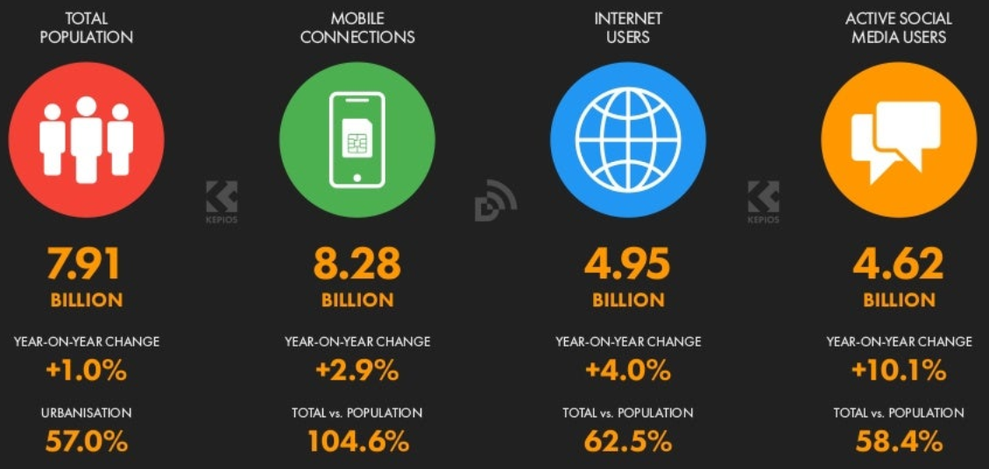
Media Sosial di Dunia
Pengguna media sosial dunia = 58,4% dari total populasi

Slide 7
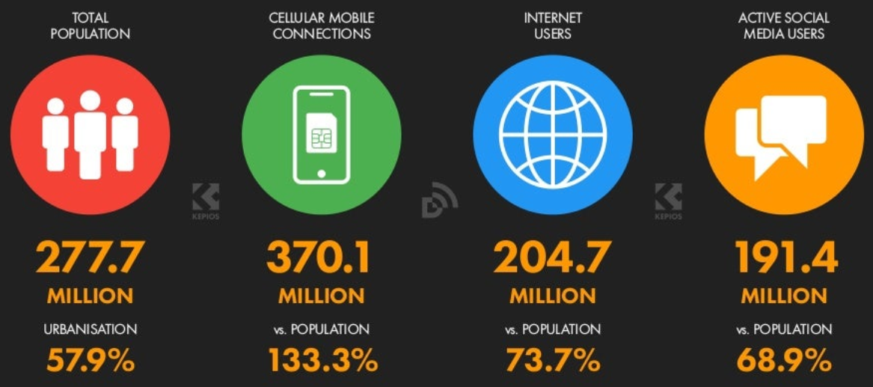
Media Sosial di Indonesia
Pengguna media sosial di Indonesia = 68,9% dari total populasi

Slide 8
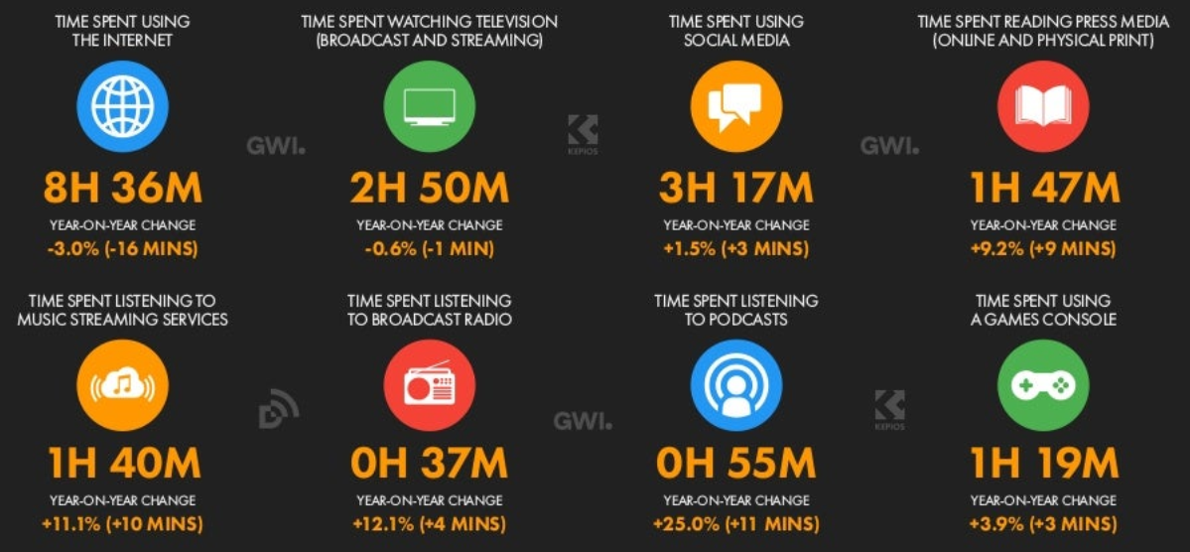
Media Sosial di Indonesia
Setiap harinya, waktu yang dihabiskan untuk main medsos adalah 3 jam 17 menit

Slide 9
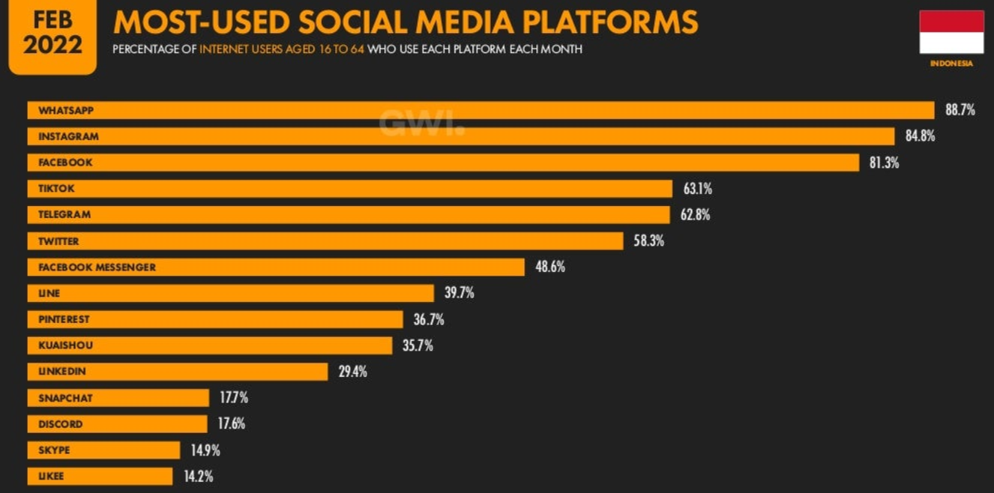
Media Sosial di Indonesia

Slide 10
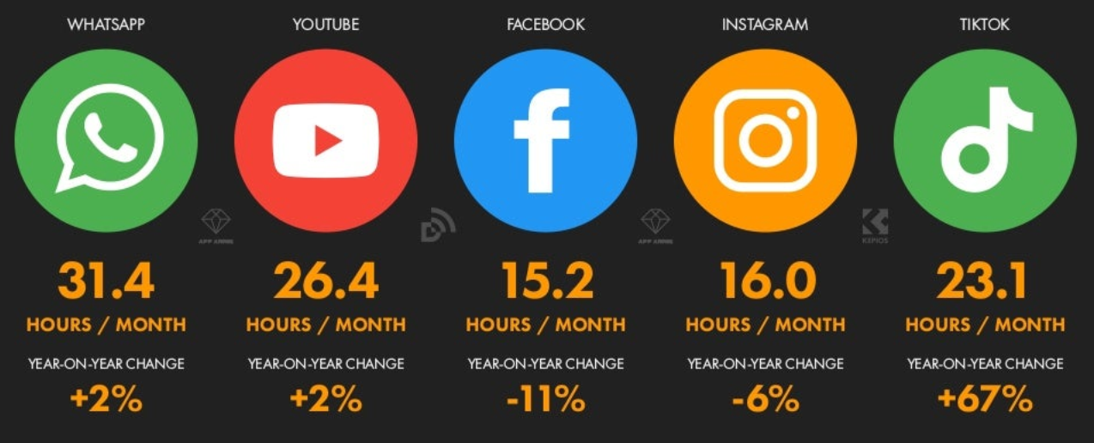
Media Sosial di Indonesia
Waktu yang dihabiskan untuk akses Whatsapp adalah 31,4 jam / bulan

Slide 11
JENIS MEDIA SOSIAL

Slide 12



Jenis dari Media Sosial
Social Networking Sites
Focused on online social relationships among users
Allow users to
(1) construct a public or semipublic profile,
(2) establish links (friendship) and relationships with other SNS users, and
(3) view and traverse their list of connections and those made by others within the system.
Examples: Facebook, Google+, Linkedin

Slide 13



Jenis dari Media Sosial
Content Communities
A group of people coalescing online around an object of interest held in common. The object can be just about anything for example, photos, videos, links, topic or issue, and is often organized and developed in a way that either includes social network elements or makes them central to the content.
Examples: Youtube, Instagram, Flickr, etc

Slide 14
Jenis dari Media Sosial
Blogs
Online personal space or website where an individual (or organization) posts content (text, images, videos, and links to other sites) and expresses opinions on matters of personal (or organizational) interest on a regular basis.
Main features:
Interactivity —Readers have the ability to leave comments in response to a blog post.
Archives —Blogs provide archives of past blog entries stored in reverse chronological order (that is, the most recent appears first).
Subscription —Internet users can subscribe to blogs.
Focused —Most blogs are focused on a certain area of interest
Examples of blogging platform: Wordpress, Blogger

Slide 15
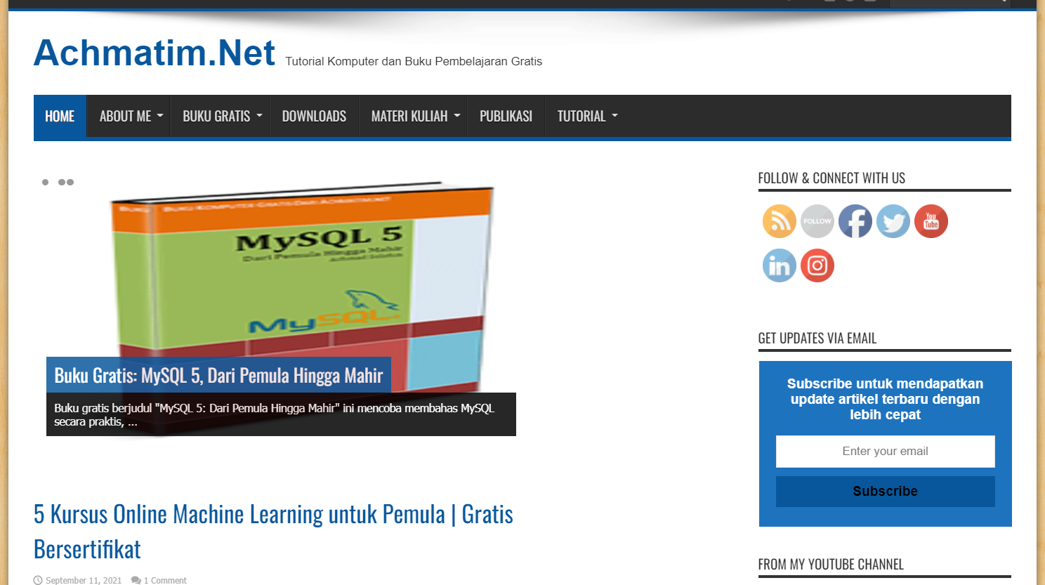
Contoh Blog

Slide 16



Jenis dari Media Sosial
Microbloggings
A miniature version of blogging that allows users to exchange/publish brief messages, including text, images, or links to other websites.
Micro-blogs allow users to exchange small elements of content such as short sentences, individual images, or video links, which may be the major reason for their popularity. These small messages are sometimes called micro posts
Examples: Twitter, Tumblr, Pinterest, etc

Slide 17


Jenis dari Media Sosial
Online Collaboration Projects
Online collaborative projects/tools allow people to plan, coordinate, add, control, and monitor content in collaboration with others.
At the core of the online collaborative projects is the concept of wiki. A wiki is a type online content management system that allows users to add, modify, or delete content simultaneously in collaboration with others
Examples: Wikipedia, Github, etc

Slide 18


Jenis dari Media Sosial
Folksonomies or Social Tagging
Also known as collaborative tagging, social classification, social indexing, and social tagging
Organizing data and content (through tagging) from a user’s perspective.
Allows users to tag, organize, classify, and share content (web addresses or sites) in their own unique ways
Examples: Del.icio.us, Pinterest, Bibsonomy, etc

Slide 19
Jenis dari Media Sosial
Virtual Worlds
Virtual worlds is computer-generated online environments. It can take the form of a three-dimensional (3-D) virtual social world (e.g., Second Life) where people digitally represent themselves in the form of avatars and interact with others through text and voice messaging
Examples: Metaverse
Mobile Apps
Mobile apps are special-purpose tools developed to perform a variety of activities we do every day while on the move, such as communicating, social networking, sharing information, and shopping.
Examples: Tokopedia, Shopee, Gojek, etc

Slide 20

Terminologi Media Sosial: Facebook
Facebook structure
News Feed
Friends
Wall
Timeline (Pages)
Likes and Reactions
Comments
Messages and inbox
Notifications
Groups
Applications
Events
Marketplace
Notes
Places
Platform
Facebook Questions
Photos
Videos (Live streaming, Controversial use)
Facebook Paper
Facebook Mentions
Facebook Moments
Facebook Gaming

Slide 21

Terminologi Media Sosial: Twitter
Twitter terminologies:
Tweet (now 280 char)
Retweet (RT)
Direct message (DM)
Following
Follower
Mention
Hashtag (#)
Features:
Tweet
Lists
Moments
Trendings
Polls
Streaming video
Spaces
Fleets
GIF Search

Slide 22

Terminologi Media Sosial: Instagram
IG Terminologies:
Bio
Caption
Comments
Filters
Followers
Hashtag
Instagram Live
Like
Post
Story
Main Features:
Photos
Videos
Reels
IGTV (IG Live)
Stories
Messenger
Shopping
Search & Explore

Slide 23
Data apa saja yang dapat diperoleh dari media sosial?
Engagement: Clicks, comments, shares, etc.
Reach
Impressions and video views
Follower count and growth over time
Profile visits
Brand sentiment
Social share of voice
Demographic data: age, gender, location, language, behaviors, etc.
Notes:
Source: https://blog.hootsuite.com/social-media-data-collection/

Slide 24
Tren Penelitian pada Media Sosial
Platform | Google Scholar | Garuda | IEEE | DOAJ
Twitter | 7.840.000 | 1.258 | 9.074 | 6.038
Facebook | 7.120.000 | 1.327 | 7.634 | 7.591
Youtube | 6.600.000 | 1.502 | 3.145 | 3.048
Linkedin | 4.230.000 | 15 | 507 | 338
Instagram | 2.480.000 | 2.932 | 659 | 2.385
Github | 2.000.000 | 5 | 6.241 | 1.088
Whatsapp | 600.000 | 1.179 | 335 | 1.988
Telegram | 548.000 | 307 | 269 | 375
Tiktok | 44.600 | 197 | 59 | 152

Slide 25
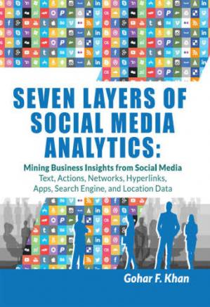



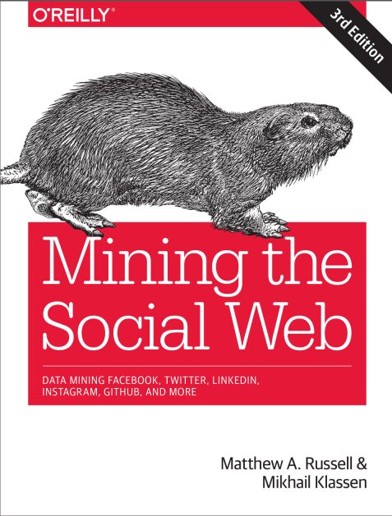
Referensi / Buku

Slide 26


Kesimpulan
TERIMA KASIH

